Slide 1
Asynchronous Javascript and XML

Slide 2
What can we do with AJAX?
Ajax is a methodology of designing web applications , so that they have the look and feel of desktop applications
AJAX is an acronym for Asynchronous JavaScript And XML
Provides an ability to communicate with the server asynchronously
Request can be sent to the server and continue interaction with the user
Need not wait for response from the server
Once the response arrives, a designated area in UI will update itself and reflect the response information
Whole page need not be reloaded.
With Ajax, it is possible to
Update a web page without reloading the page
Request data from a server - after the page has loaded
Receive data from a server - after the page has loaded
Send data to a server - in the background

Slide 3
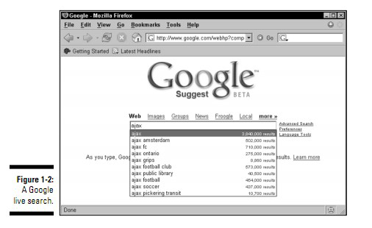
Applications of Ajax – Live searches
Get search results instantly, as the search term is entered
Ajax contacts Google behind the scenes
Drop-down menu displays common search terms from Google that might match what the entered search term
Possible to select one of those terms and just click it in the menu.

Slide 4
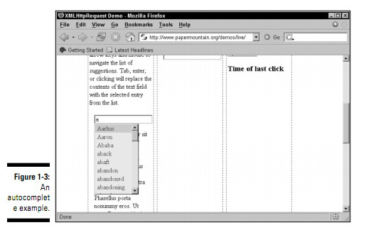
Applications of Ajax – Auto Complete
Closely related to live search applications complete applications
Try to guess the word and bring a list of similar words from the server and displaying them.

Slide 5
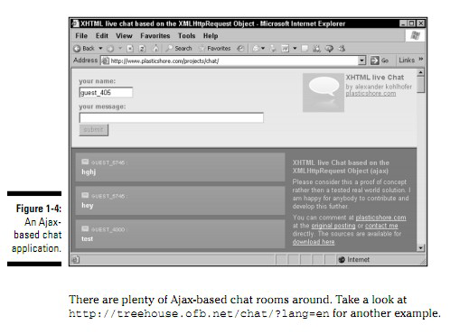
Applications of Ajax – Chat
Ajax excels at updating Web pages without refreshing the displayed page
It’s a great choice for Web-based chat programs, where many users can chat together at the same time.

Slide 6
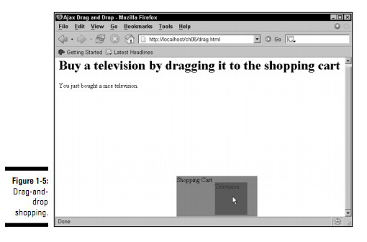
Applications of Ajax – Chat
When the user drags the television to the shopping cart the server is notified that the user bought a television.
Server sends back the text “You just bought a nice television.”

Slide 7
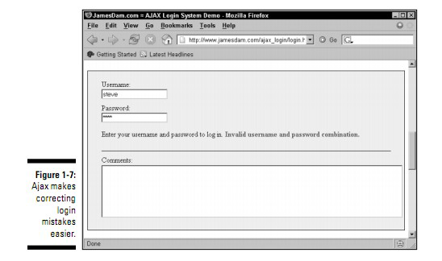
Applications of Ajax – Login Feedback
Another Internet task that can involve many
annoying page refreshes is logging in to a site.
If you type the wrong login name, for example, you get a new page explaining the problem
Need to log in on another page, and so on.
How about getting instant feedback on your login attempt?

Slide 8
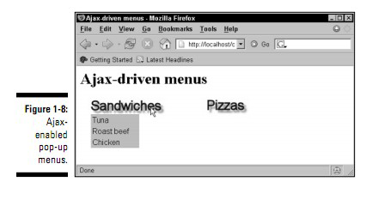
Applications of Ajax – Popup Menus
The pop-up menus appear when you move the mouse
display text retrieved from the server using Ajax techniques.
By accessing the server, Ajax allows you to set up an interactive menu system that responds to the menu choices the user has already made.

Slide 9
How to implement AJAX application?
XMLHttpRequest object is utilized for sending the request.
Browser provides the capability for XMLHttpRequest object.
Most modern browsers provides support for XMLHttpRequest.
This object helps for http request and process XML response

Slide 10
Properties of XMLHttpRequest
XMLHttpRequest consists of properties readyState, status, statusText, responseText
readyState denotes states as
0 – UNINITIALIZED
1 – LOADING
2 – LOADED
3 – INTERACTIVE
4 – COMPLETE.
status is HTTP status code for the response
statusText is HTTP status message for the status code
responseText is response text from server

Slide 11
Event in XMLHttpRequest
XMLHttpRequest contains an event ‘onreadystatechange’
It is invoked whenever ‘readyState’ property given above changes
Need to register a function for the above event ‘onreadystatechange’
xhttp.open("GET", "ajax_info.txt", true);
The third argument ‘true’ represents asynchronous
xhttp.send();

